Slide 1
“Image De-fencing using Microsoft Kinect”
Vikram Voleti [09EE3501]
Guide: Rajiv Ranjan Sahay

Slide 2
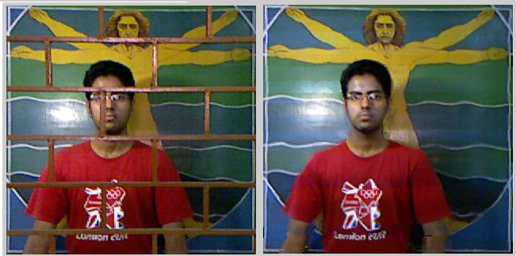
Abstract: De-fencing of Images
Use of RGB-D data to detect fence
Capture multiple views of the same scene to borrow information
Inpaint fence regions using Loopy Belief Propagation
2/41

Slide 3
Contents
1. Introduction
2. The Proposed Algorithm
3. Detection of Fences
4. Alignment of Depth and Colour Images
5. Computation of Shifts Between Images
6. Inpainting of Fence Region
7. Experimental Results
8. Comparison with Other Methods
9. Precautions
10. Conclusion
Bibliography
3/41

Slide 4
1. Introduction
4/41

Slide 5
1. Introduction
Objective:
To remove fences/occlusions from images
Novelty:
Use of depth maps (from Microsoft Kinect) to detect fences
Scope of Work:
Capture image data to de-fence
Experiment with different parameters such as type of fence, types of subjects, lighting conditions, etc.
Design methodology to align depth map with colour image
Experiment with algorithms required to calculate pixel shifts between images
Code required operations in MATLAB
5/41

Slide 6
1. Introduction
Work completed:
Prepared workflow for capturing images using Microsoft Kinect
Experimented with external parameters such as lighting, number of multiple views, types of fences, types of subjects, lighting conditions, etc.
Designed methodology to align depth map with colour image
Captured multiple images and removed fences
Experimented with algorithms to calculate shifts between multiple images
Experimented with preprocessing steps required to detect fences in images
Wrote original code, except for Loopy Belief, in MATLAB
Optimized Loopy Belief code; brought down time taken to de-fence one colour image from around 30 minutes to less than 3 minutes
6/41

Slide 7
2. Proposed Algorithm
7/41

Slide 8
2. Proposed Algorithm
1 Detection of Fence
- Using depth map (Microsoft Kinect)
2 Computation of Pixel Shifts between Images
- 3 methods explored
3 Inpainting of Fence Region
- Using Loopy Belief Propagation
8/41

Slide 9
Proposed Algorithm:
1 Detection of Fence
2 Computation of Pixel Shifts
3 Inpainting of Fence Region
3. Detection of Fence
9/41

Slide 10
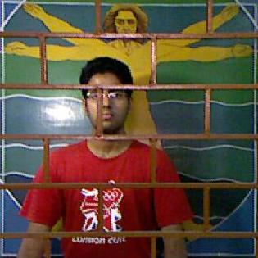
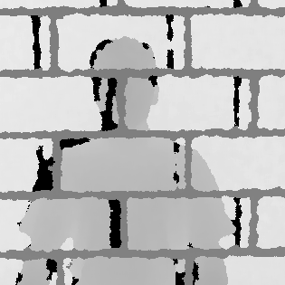
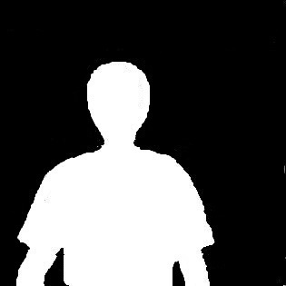
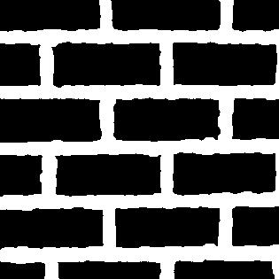
3. Detection of Fence
RGB Data
D
Data
Foreground segmented out of depth map
Fence (aligned) segmented out of depth map
10/41

Slide 11
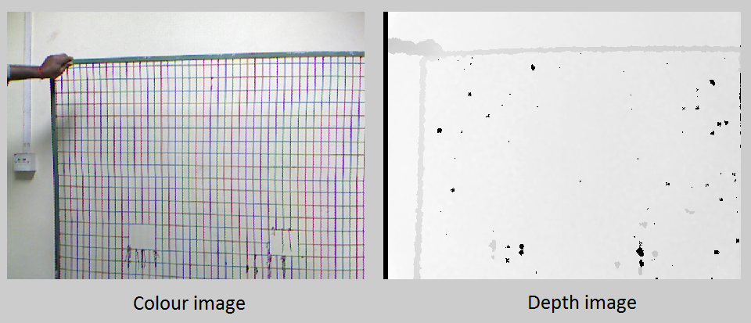
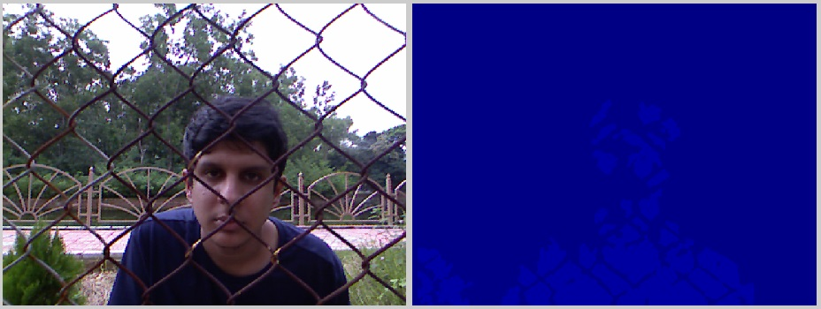
3. Detection of Fence
Failure Cases
1) Minimal reflection from fence
2) Over-exposure to infrared light
11/41

Slide 12
4. Alignment of Depth & Colour Images
12/41

Slide 13
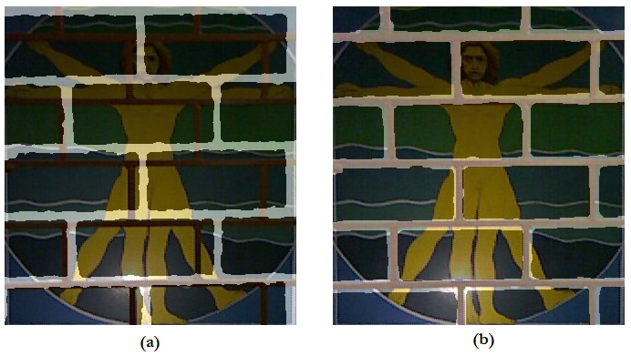
4. Alignment of Depth & Colour Images
Not aligned
Aligned
Scaling
13/41

Slide 14
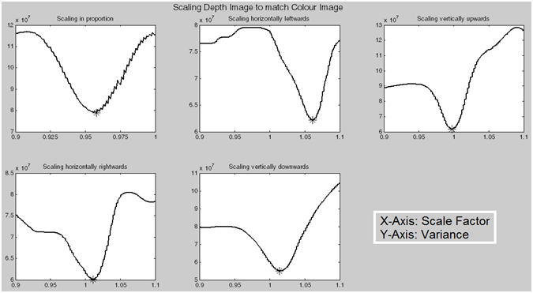
4. Alignment of Depth & Colour Images
14/41

Slide 15
Proposed Algorithm:
1 Detection of Fence
2 Computation of Pixel Shifts
3 Inpainting of Fence Region
5. Computation of Pixel Shifts
1) Naive algorithm
2) Optical Flow
3) ASIFT
15/41

Slide 16
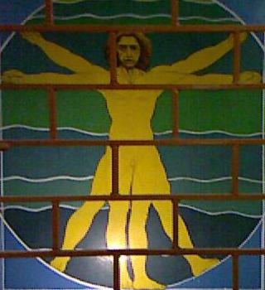
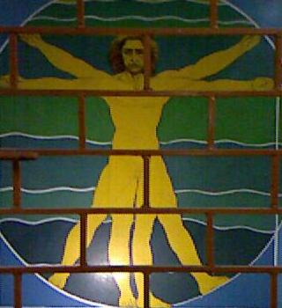
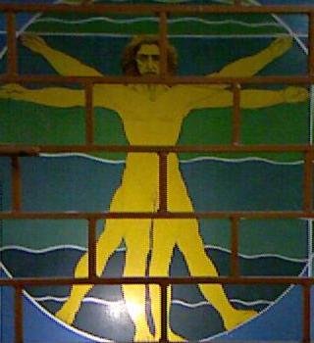
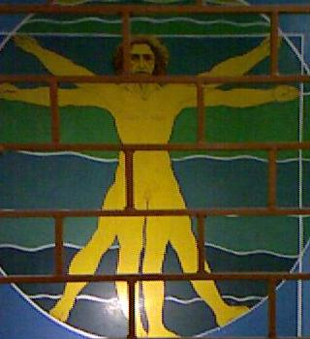
5. Computation of Pixel Shifts
Reference Image
Test Images
Assumption: Global motion
16/41

Slide 17
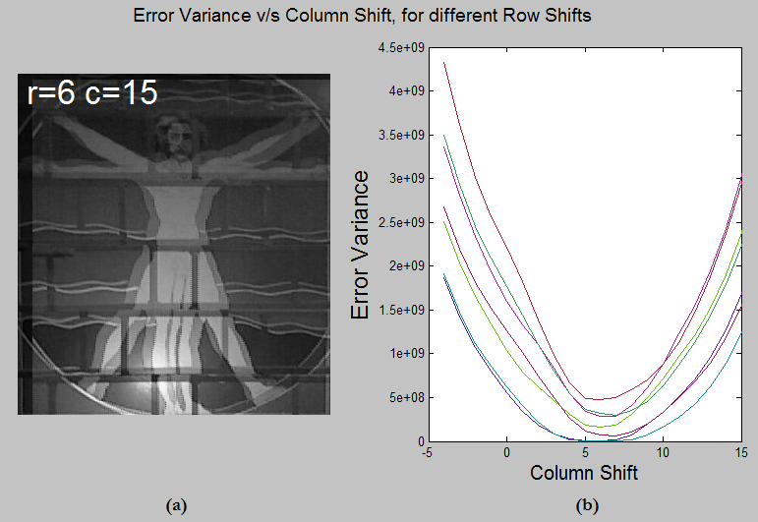
5. Computation of Pixel Shifts
1) Naive algorithm
Error Variance = variance[non-fence(Reference_Image - shift(Test_Image))]/(number of non-fence pixels)^(a convenient power)
17/41

Slide 18
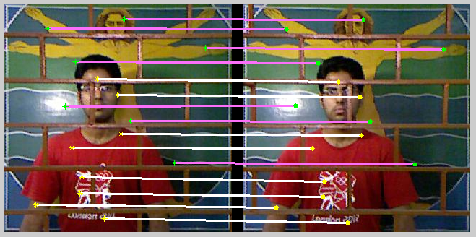
5. Computation of Pixel Shifts
2) Optical Flow
- Cannot handle occlusions
3) Affine Scale-Invariant Feature Transform (ASIFT)
18/41

Slide 19
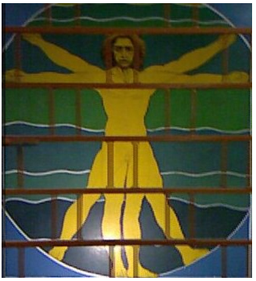
5. Computation of Pixel Shifts
Superimposition of Reference Image and Shifted Test Image
19/41

Slide 20
Proposed Algorithm:
1 Detection of Fence
2 Computation of Pixel Shifts
3 Inpainting of Fence Region
6. Inpainting of Fence Region
20/41

Slide 21
6. Inpainting of Fence Region
De-fenced image is modelled as a Markov Random Field
Degradation Model:
y_{m} = O_{m}.W_{m}.x + n_{m}
x is De-fenced image,
W_{m} is Warp matrix: describes the Pixel Shift from Reference Image,
O_{m} is an operator that crops out non-fence regions from x,
y_{m} is observed image,
n_{m} is noise, assumed to be Gaussian.
21/41

Slide 22
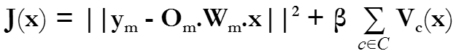
6. Inpainting of Fence Region
Cost function
Data term
Smoothness term
Regularization parameter
Clique Potential function V_{c}(x)
= |x_{i,j} - x_{i,j+1}| + |x_{i,j} - x_{i,j-1}| + |x_{i,j} - x_{i-1,j}| + |x_{i,j} - x_{i+1,j}|
= arg min_{x} (J(x))
using Loopy Belief Propagation
22/41

Slide 23
7. Experimental Results
23/41

Slide 24
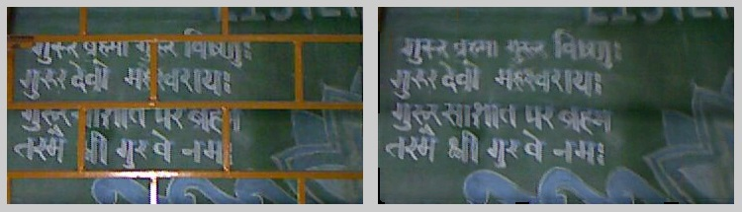
7. Experimental Results
Rectangular fence with single object: Board
24/41

Slide 25

7. Experimental Results
Rectangular fence with single object: Poster
25/41

Slide 26
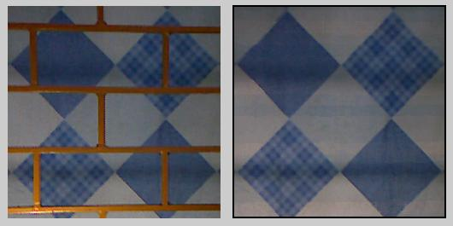
7. Experimental Results
Rectangular fence with single object: Bedsheet
26/41

Slide 27
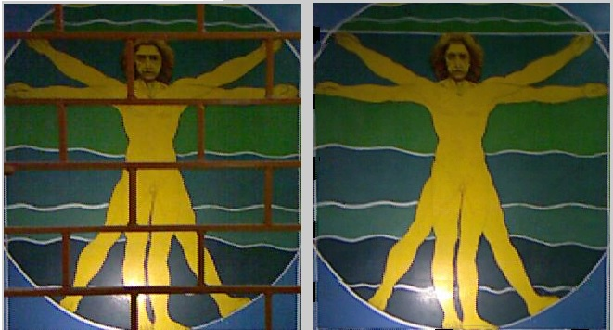
7. Experimental Results
Rectangular fence with single object: Painting
27/41

Slide 28
7. Experimental Results
Rectangular fence with two objects
28/41

Slide 29
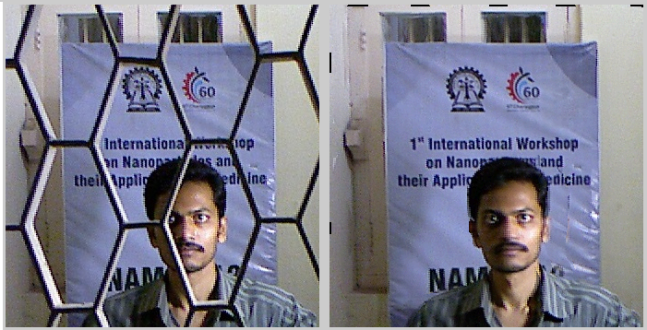
7. Experimental Results
Diagonal fence with two objects
29/41

Slide 30
8. Comparison with Other Methods
1) Total Variation Inpainting using Split Bregman
2) De-fencing using Learning-Based Matting
30/41

Slide 31
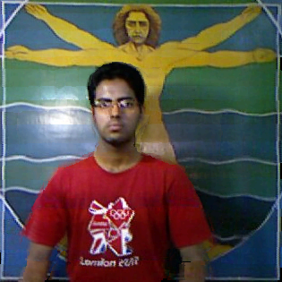
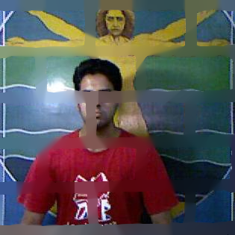
8. Comparison
1) Total Variation Inpainting using Split Bregman
Using Proposed Algorithm
Using Total Variation Inpainting using Split Bregman
31/41

Slide 32
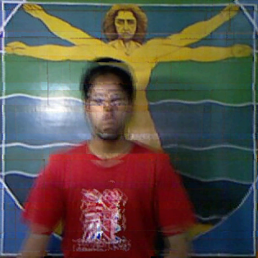
8. Comparison
2) De-fencing using Learning-Based Matting
Using Proposed Algorithm
Using De-fencing using Learning-Based Matting
32/41

Slide 33
9. Precautions
1) Sufficient Fence Dilation
2) Sufficient Camera Translation
3) Limited Pixel Shift
33/41

Slide 34
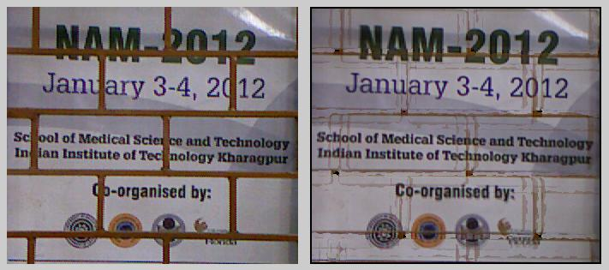
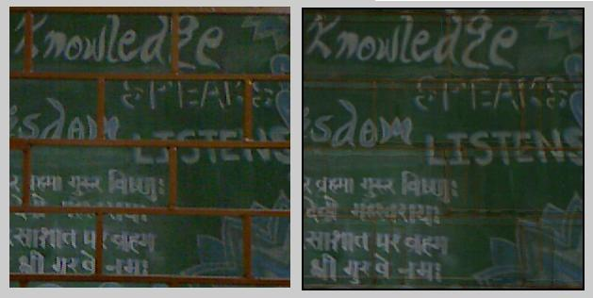
9. Precautions
1) Sufficient Fence Dilation
34/41

Slide 35
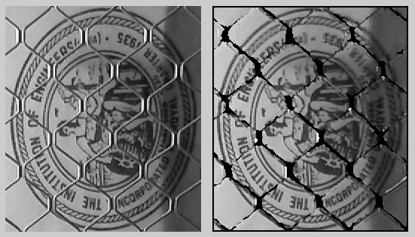
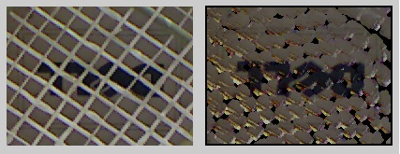
9. Precautions
2) Sufficient Camera Translation
35/41

Slide 36

9. Precautions
3) Limited Pixel Shift
36/41

Slide 37
10. Conclusion
37/41

Slide 38
10. Conclusion
Prepared workflow for capturing images using Microsoft Kinect
Designed methodology for aligning depth map with colour image
Explored different methods for computing Pixel Shifts between multiple images
Optimized Loopy Belief code
Captured and performed de-fencing of various images with different fences, subjects, etc.
Submitted research paper to ACM Multimedia 2014, the 22nd International Conference on Multimedia
38/41

Slide 39
Bibliography
[1] Baker, S., Scharstein, D., Lewis, J., Roth S., Black, M. J., and Szeliski, R., “A database and evaluation methodology for optical ﬂow,” in International Conference on Computer Vision (ICCV), 2007.
[2] Bertalmío, M., Sapiro, G., Caselles, V., and Ballester, C., “Image inpainting,” ACM Transactions on Graphics (SIGGRAPH ’00), Proceedings of the 27th annual conference on Computer graphics and interactive techniques, 2000, pp. 417–424. http://dx.doi.org/10.1145/344779.344972
[3] Boykov, Y., and Kolmogorov, V., “An experimental comparison of min-cut/max-ﬂow algorithms,” IEEE Transactions on Pattern Analysis and Machine Intelligence, vol. 26, no. 9, pp. 1124–1137, 2004.
[4] Chellappa, R., Jain, A., “Markov Random Fields: Theory and Applications,” Academic Press, London, 1993.
[5] Criminisi, A., Perez, P., and Toyama, K., “Region ﬁlling and object removal by examplar-based image inpainting,” IEEE Transaction on Image Processing, vol. 13,pp. 1200–1212, 2004.
[6] Cruz, L., Lucio, D., and Velho, L., “Kinect and RGBD Images: challenges and applications,” in 2012 XXV SIBGRAPI Conference on Graphics, Patterns and Images Tutorials.
[7] Forsyth, D. A., “Shape from texture without boundaries,” in Proc. European Conf. Computer Vision (ECCV), pp. 225–239, 2002.
[8] Getreuer, P., “Total variation inpainting using Split Bregman,” Image Processing On Line, 2:147-157, 2012.
[9] Han, J., Shao, L., Xu, D., and Shotton, J., “Enhanced computer vision with Microsoft Kinect sensor: a review,” IEEE Transactions on Cybernetics.
[10] Hays J., and Efros, A., “Scene completion using millions of photographs,” ACM Transactions on Graphics (SIGGRAPH 2007), vol. 26, no. 3, 2007.
[11] Hays, J., Leordeanu, M., Efros, A., and Liu, Y., “Discovering texture regularity as a higher-order correspondence problem,” in European Conference on Computer Vision (ECCV ’06), 2006.
[12] Hg, R. I., Jasek, P., Rofidal, C., Nasrollahi, K., Moeslund, T. B., and Tranchet, G., “An RGB-D Database Using Microsoft’s Kinect for Windows for Face Detection,” Eighth International Conference on Signal Image Technology and Internet Based Systems, 2012.
39/41

Slide 40
Bibliography
[13] Huttenlocher, D. P., and Felzenszwalb, P. F., “Efficient belief propagation for early vision,” International Journal of Computer Vision, vol. 70, pp. 41–54, 2006.
[14] Khasare, V., and Sahay, R., “Seeing through the fence: image de-fencing using a video sequence,” 2013 IEEE International Conference on Image Processing, Restoration and Enhancement III.
[15] Leung, T. K., and Malik, J., “Detecting, localizing and grouping repeated scene elements from an image,” in Proc. European Conf. Computer Vision (ECCV), pp. 546–555, 1996.
[16] Li, S. Z., Markov Random Field modeling in image analysis, Springer, Heidelberg, 2001.
[17] Liu, Y., Belkina, T., Hays, J., and Lublinerman, R., “Image de-fencing,” in IEEE Conference on Computer Vision and Pattern Recognition, 2008, pp. 1–8.
[18] Liu, Y., Collins, R., and Tsin, Y., “A computational model for periodic pattern perception based on frieze and wallpaper groups,” IEEE Transaction on Pattern Analysis and Machine Intelligence, 26(3):354–371, March 2004.
[19] Lowe, D. G., “Object recognition from local scale-invariant features,” in International Conference on Computer Vision, Corfu, Greece, pp. 1150–1157, 1999.
[20] Morel, J. M., and Yu, G., “ASIFT, A new framework for fully affine invariant image comparison,” SIAM Journal on Imaging Sciences, 2(2):438–469, 2009.
[21] Park, M., Brocklehurst, K., Collins, R. T., and Liu, Y., “Image de-fencing revisited,” in Asian Conference on Computer Vision, 2011, pp. 422–434.
[22] Park, M., Collins, R. T., Liu, Y., “Deformed lattice discovery via efficient mean-shift belief propagation,” in 10th European Conference on Computer Vision, Marseille, France, 2008.
[23] Park, M., Collins, R. T., Liu, Y., “Deformed lattice detection in real-world images using mean-shift belief propagation,” IEEE Transactions on Pattern Analysis and Machine Intelligence (PAMI), vol. 31, no. 10, pp. 1804–1816, 2009.
40/41

Slide 41
Bibliography
[24] Rangarajan, A., Chellappa, R., “Markov Random Field models in image processing,” The Handbook of Brain Theory and Neural Networks, pp. 564-567, MIT Press, 1995.
[25] Schaffalitzky, F., and Zisserman, A., “Geometric grouping of repeated elements within images,” in Shape, Contour and Grouping in Computer Vision, pp. 165–181, 1999.
[26] Sun, D., Roth, S., and Black, M., “Secrets of optical flow estimation and their principles,” in IEEE Conference on Computer Vision and Pattern Recognition, pp. 2432–2439, 2010.
[27] Sun, J., Zheng, N. N., and Shum, H. Y., “Stereo matching using belief propagation,” IEEE Transactions on Pattern Analysis and Machine Intelligence, 25(7):787–800, 2003.
[28] Tuytelaars, T., Turina, A., and Van Gool, L., “Non-combinatorial detection of regular repetitions under perspective skew,” IEEE Transactions on Pattern Analysis and Machine Intelligence, PAMI, 25(4):418–432, 2003.
[29] Willsky, A. S., “Multiresolution markov models for signal and image processing,” Proceedings of the IEEE, 90(8):1396–1458, 2002.
[30] Yu, G., and Morel, J. M., “ASIFT: An algorithm for fully affine invariant comparison,” Image Processing On Line, 1 (2011). http://dx.doi.org/10.5201/ipol.2011.my-asift
[31] Zheng, Y., and Kambhamettu, C., “Learning based digital matting,” in IEEE International Conference on Computer Vision (ICCV), 2009, pp. 889–896.
41/41

Slide 42
Thank you.

